Slide 1

Microservice Architecture with Spring Boot – Advanced Concepts
- Guru

Slide 2
Agenda
Consuming Microservices in JSPs (Creating web client)
CORS support
AJAX call without and with CORS support
SPA (Single Page Application)
Gateway API (Zuul)
Spring Boot Actuator (monitoring)
Internationalization (i18n)

Slide 3
Web application for microservices
So far we have seen how to consume microservices in REST client such as postman
But, if we want to source data from microservices and show in my view (such as Customers.jsp), how to do?
We can convert one of the existing microservices projects into a web application

Slide 4
Web application: Customer microservice
Open the project Customer microservice in STS
Make sure it is working
Add the following dependency in pom.xml
<!– This dependency enables JSP usage -->
<dependency>
<groupId>org.apache.tomcat.embed</groupId>
<artifactId>tomcat-embed-jasper</artifactId>
<scope>provided</scope>
</dependency>

Slide 5
Web application: Customer microservice
Under /src/main folder, create /WEB-INF/views folder manually
Create a JSP page with the name “allCustomers.jsp”
We are going to show the result of Customer microservice in this jsp for the URI /customers
We need to write some scriptlets in this JSP
Let’s create a HTML table with the columns: customer id, customer name, flat no, street name, city, pincode, stockids

Slide 6
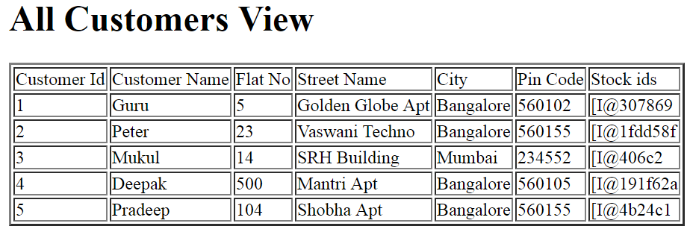
Web application: Customer microservice
The final rendered view would look like this
This is allCustomers.jsp

Slide 7
Web application: Customer microservice
Let’s modify the method “getCustomerList()” from CustomerController class as follows:
@RequestMapping(value="/customers",method=RequestMethod.GET)
public String getCustomersList(ModelMap map)
{
map.addAttribute("allCustomers",allCustomers);
return "allCustomers";
}

Slide 8
Code allCustomers.jsp
In this JSP:
Get the model (data) from the CustomerController
<%
List<Customer> allCustomers=(List<Customer>)request.getAttribute("allCustomers");
%>
Then Iterate this List, and using the getter methods from the customer object, and show in different columns of the table

Slide 9
CORS Support
Stands for Cross-Origin Resource Sharing
a security concept that allows restricting the resources implemented in web browsers.
It prevents the JavaScript code producing or consuming the requests against different origin.
Assume, your web application is running on 8081 port and by using JavaScript you are trying to consume RESTful web services from 9091 port. Under such situations, you will face the Cross-Origin Resource Sharing security issue on your web browsers.

Slide 10
CORS Support
You can handle this situations in the following two ways:
RESTful web services should support the Cross-Origin Resource Sharing.
RESTful web service application should allow accessing the API(s) from the 8080 port.
We need to configure it

Slide 11
CORS Support
Enabling CORS is straightforward – just add the annotation @CrossOrigin.
@CrossOrigin
@RequestMapping("/customers")
public List<Customer> getAllCustomers()
{
System.out.println("@EnableAutoConfiguration ");
return customerService.getAllCustomers();
}
CORS is enabled for getAllCustomers() method

Slide 12
CORS Support
We didn’t set any configuration for the @CrossOrigin annotation, so the default configuration takes place:
All origins are allowed
The HTTP methods allowed are those specified in the @RequestMapping annotation (for this example is GET)
The time that the preflight response is cached (maxAge) is 30 minutes

Slide 13
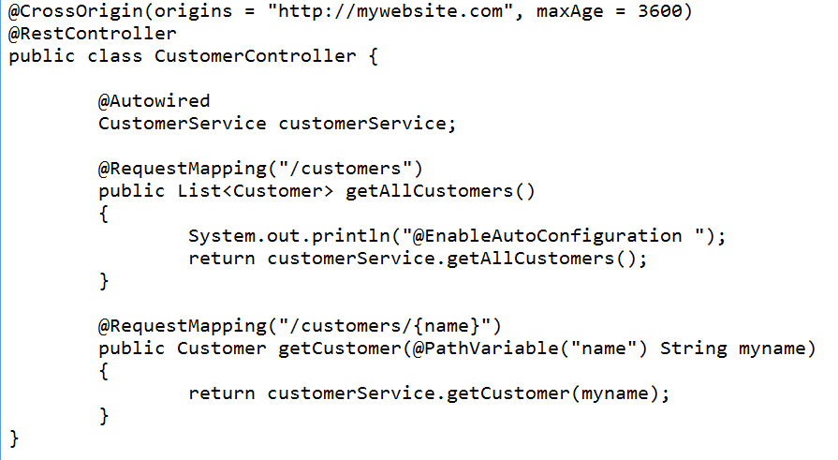
@CrossOrigin at class level

Slide 14
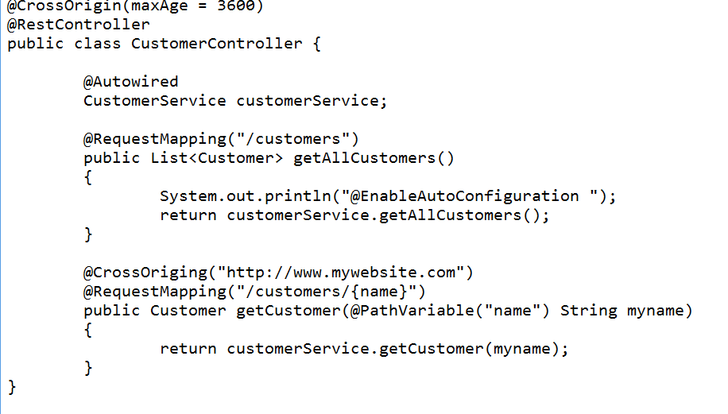
Merged @CrossOrigin

Slide 15
CORS Support for Customer Microservices
Let’s create a new dynamic web project
Let’s create an HTML page and add a JavaScript function
From this function, let’s invoke the Customer Microservice on click of a button
If the data (model) is obtained, let’s show in the <div> tag in the HTML page
Invoking the Customer Microservice is done through AJAX call

Slide 16
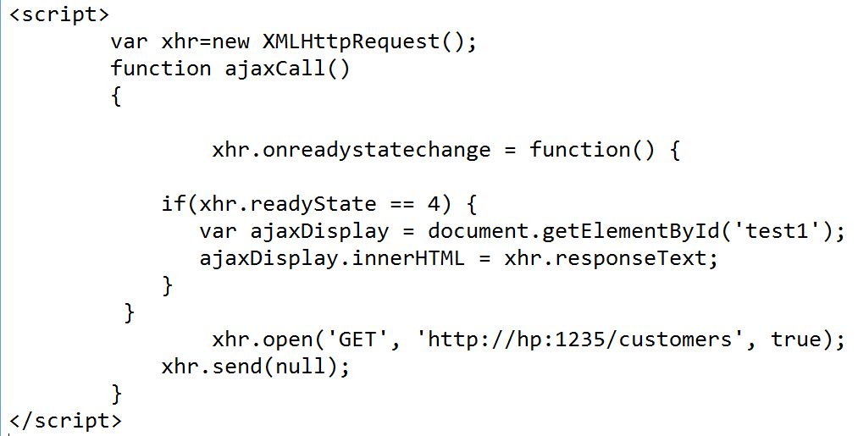
AJAX call in HTML
Dynamic project name is: ClientUI
Just create an HTML page with the name UIPage.html
Create the JavaScript function to make a AJAX call

Slide 17
AJAX call in HTML
The HTML body is:
<body>
<h1> Single Page Application (SPA)</h1>
<button onclick="ajaxCall()">Ajax call </button>
<div id="test1"></div>
</body>

Slide 18
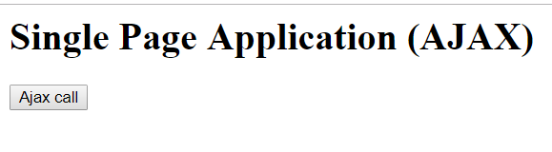
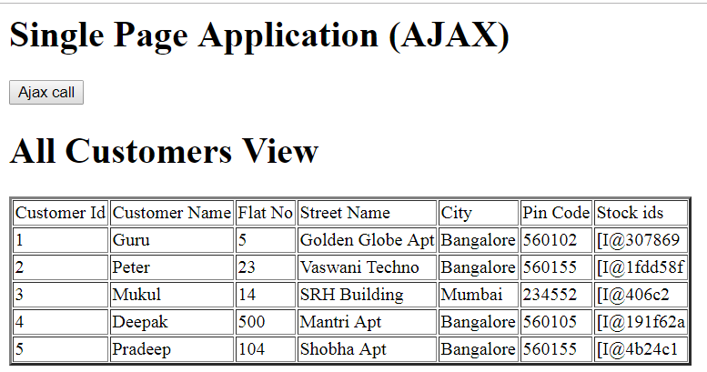
SPA with AJAX (UI layer)
CLICK

Slide 19
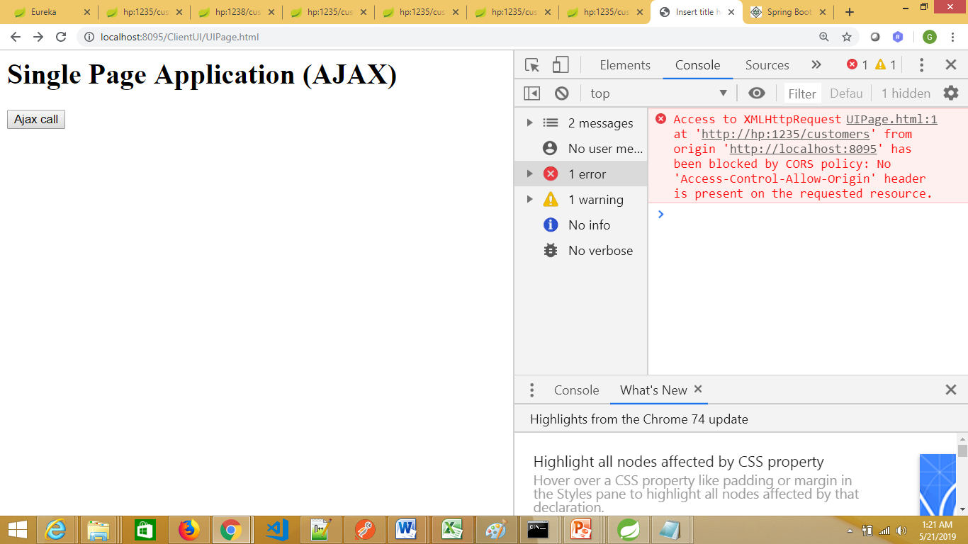
SPA with AJAX (UI layer)
After clicking the button, if you are unable to see the data, CORS support is disabled for this microservice
Open the developer tool, and you could see the error message.
Both the client (UI) and the server (microservice) belongs to different port number

Slide 20
Enabling CORS support
If you want to enable CORS support to Customer microservice:
Open the Controller method for displaying all customers
Just add the annotation @CrossOrigin before the method getCustomersList()

Slide 21
Gateway APIs
Accessing different microservices is a tedious job
Imagine we have 50 microservices in our project
We can’t remember all the microservices names and also the port numbers.
So, we are going to put one more microservice (call it as gateway api microservice) in front of the Customers, Stock, SecurityBond microservices
In this microservice, we are going to write the routing logic
Example: Any HTTP requests come with the URI “customers”, this will be redirected to Customers-microservice

Slide 22
Why Gateway API: Use case
In a complex business domain, more than 50-100 microservices is very common.
now we have to implement a UI which is kind of a dashboard, so it calls multiple services to fetch and show the important information in the UI.
From a UI developer perspective, to collect information from fifty underlying microservices, it has to call fifty REST APIs, as each microservice exposes a different REST API for communication.
So the client has to know the details of all REST API and URL patterns/ports to call them. Certainly, it does not sound like a good design. It is kind of a breach of encapsulation; the UI has to know all microservices server/port details to query the services.

Slide 23
Zuul: the Gateway API
Zuul acts as an API gateway or Edge service.
It receives all the requests coming from the UI and then delegates the requests to internal microservices
We need to include the required .jar files in our project

Slide 24
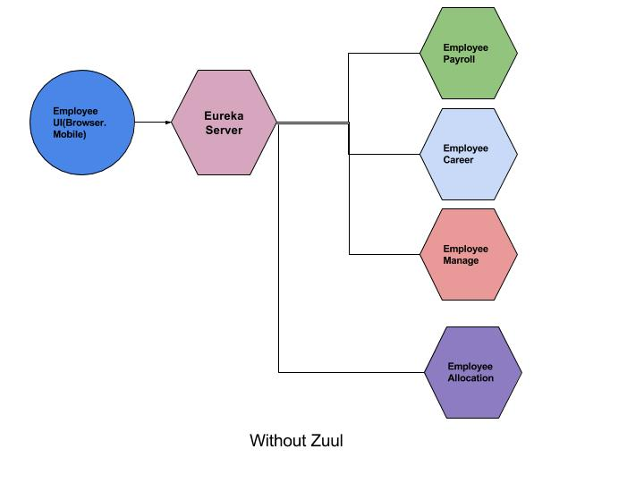
Microservices: without zuul

Slide 25
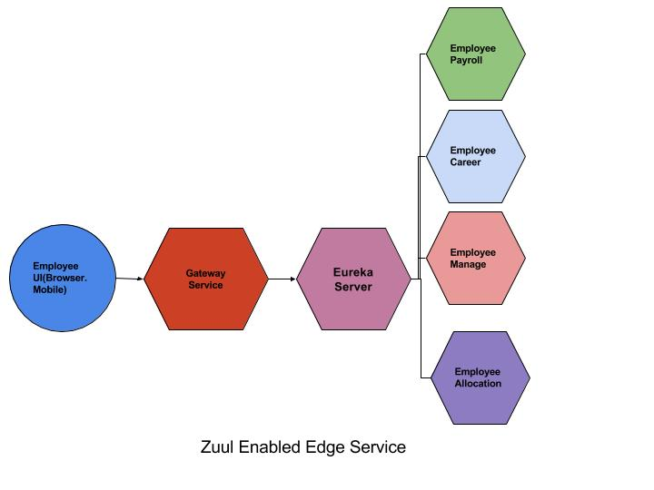
zuul gateway api (with zuul)

Slide 26
Why Gateway API: Other Use case
Think about the common aspects of a web program, like CORS, authentication, security, and monitoring in terms of this design
Each microservice needs to duplicate such aspects
Changes in the authentication requirements or CORS policy will ripple over all services. It is against the DRY principle (Don’t Repeat Yourself)
so this type of design is very error-prone and rigid.
To make it robust, it has to be changed in such way so that we have only one entry point where all common aspects code is written and the client communicates with that common service.

Slide 27
Demo: Zuul Gateway API
Create a project using Spring Starter Project
Select the following dependencies and create the project
spring-boot-starter-parent
spring-boot-starter-cloud
spring-cloud-starter-netflix-eureka-client
spring-cloud-starter-netflix-zuul
spring-boot-starter-web

Slide 28
Demo: Zuul Gateway API
Create a project using Spring Starter Project
Select the following dependencies and create the project
spring-boot-starter-parent
spring-boot-starter-cloud
spring-cloud-starter-netflix-eureka-client
spring-cloud-starter-netflix-zuul
spring-boot-starter-web
Keep the <dependencyManagement> part as it is

Slide 29
zuul gateway routing logic
All HTTP requests carrying the string “stocks/**” should be forwarded to stock-microservice
All HTTP requests carrying the string “customers/**” should be forwarded to customers-microservice
All HTTP requests carrying the string “bonds/**” should be forwarded to securitybonds-microservice
In application.yml file, we need to add the routing logic apart from specifying the spring application name, port number, eureka registry service URL

Slide 30
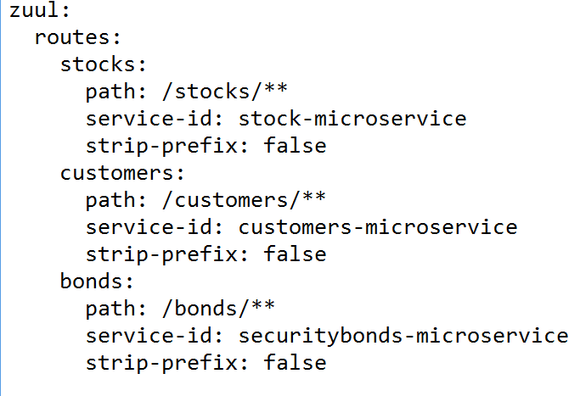
zuul gateway routing logic – application.yml

Slide 31
Demo: Zuul Gateway API
Now, write the class with main() method
We need to use the following annotations:
@SpringBootApplication
@EnableDiscoveryClient
@EnableZuulProxy
Call this class: GateWayAPIApplication

Slide 32
Demo: Zuul Gateway API
We don’t need controller class for this microservice
Now, right click the application class and run as spring boot app
In Eureka dashboard, you can see that this microservice is also registered
Now, click on API gateway microservice
Type the URI: hp:/1237/customers
You can see the customer details
Type the URI: hp:/1237/stocks
You can see the stocks details

Slide 33
Demo: Zuul Gateway API
What has happened is:
The zuul gateway receives all the requests
It checks for the string “customers”
If it is found, it routes to customers-microservice
In application.yml file, we have given:
stocks:
path: /stocks/**
service-id: stock-microservice
This means any URI has “stocks” and all sub-URIs will be forwarded to stock-microservice

Slide 34
Demo: Zuul Gateway API
So, what is the advantage?
Now, the UI developer need not to worry about the different microservices names and the port numbers
Without Zuul gateway API, the UI code would look like this:
<a href="http://hp:1235/customers">List all customers</a><br>
<a href="http://hp:1235/customers/1">List a single customer</a><br>
<a href="http://hp:1237/stocks">List all stocks</a><br>
<a href="http://hp:1237/stocks/2">List a single stock</a><br>

Slide 35
Demo: Zuul Gateway API
With Zuul gateway API, the UI code would look like this:
<a href="http://hp:1237/customers">List all customers</a><br>
<a href="http://hp:1237/customers/1">List a single customer</a><br>
<a href="http://hp:1237/stocks">List all stocks</a><br>
<a href="http://hp:1237/stocks/2">List a single stock</a><br>

Slide 36
Tell them about ngrok and excite a bit ☺
Notes:
D:\allsoftwares\ngrok-stable-windows-amd64>ngrok http 1237 (zuul gateway port no)

Slide 37
Monitoring and Managing with actuator
Spring Boot provides actuator to monitor and manage our application.
Actuator is a tool which has HTTP endpoints.
/health
/metrics
/info
/env
when application is pushed to production, you can choose to manage and monitor your application using HTTP endpoints.

Slide 38
Monitoring and Managing with actuator
We need to enable the actuator
So, add the following line in pom.xml
<dependencies>
<dependency>
<groupId>org.springframework.boot</groupId>
<artifactId>spring-boot-starter-actuator</artifactId>
</dependency>
</dependencies>

Slide 39
Monitoring and Managing with actuator
Restart the application
Access the URL: http://localhost:<port-no>/actuator
You can now see all the available endpoints
Try accessing the endpoints available now
This is called as HATEOS
(Hypermedia as the Engine of Application State)
People can refer these links to take further action in case of RESTful webservices
No separate document is needed

Slide 40
Monitoring and Managing with actuator
Now, add the following in application.properties file
info.app.name=Spring Boot Application
info.app.description=I am learning Spring Boot
info.app.version=1.0.0
management.endpoints.web.exposure.include=*
If you now access http://localhost:6789/actuator/
You can see more endpoints

Slide 41
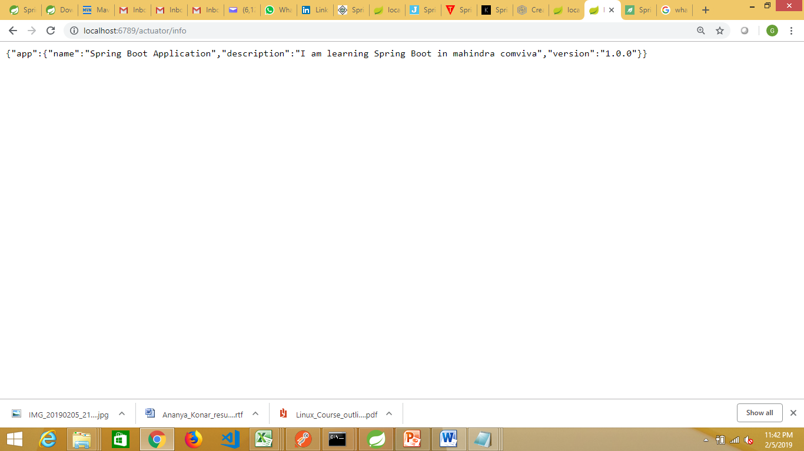
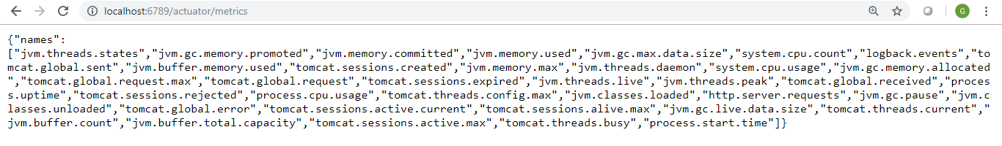
Monitoring and Managing with actuator

Slide 42
Thank You

